Slide 1
AXI DMA Driver Test Instructions
For the Kria KV260 Vision AI Starter Kit
Notes:
By Giuseppe Satta

Slide 2
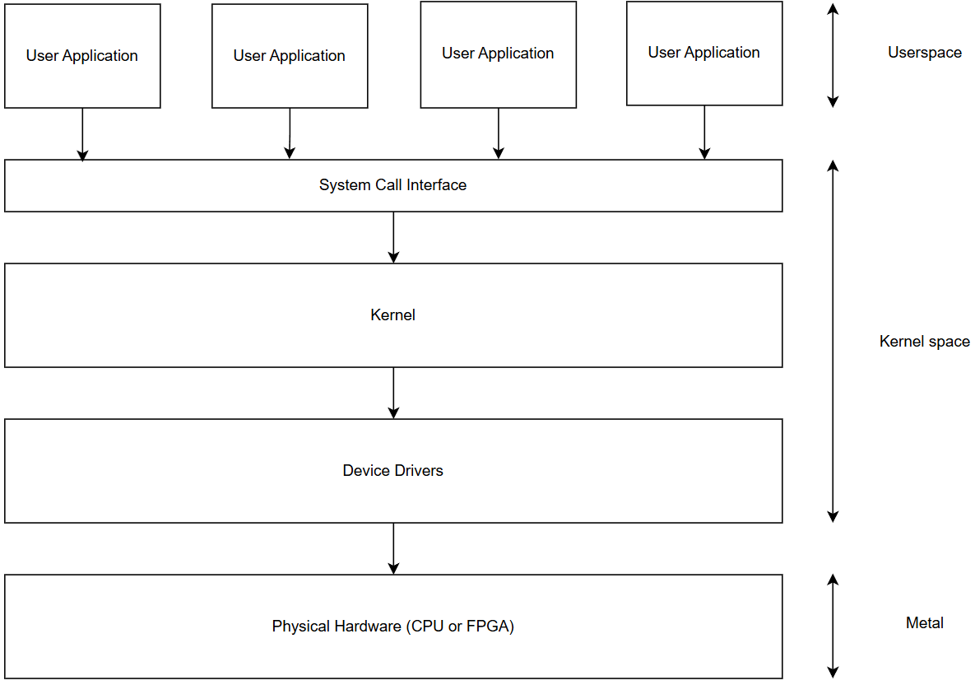
Overview
Notes:
A brief system overview. Device drivers provide a means of communication between the hardware (FPGA in this case) and the rest of the system.

Slide 3
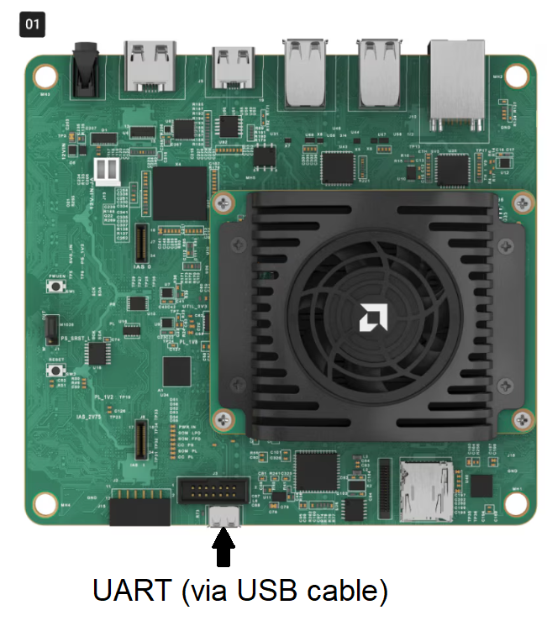
Step 1: Set up
Download the Ubuntu Desktop 22.04 LTS image from the Ubuntu website: https://ubuntu.com/download/amd#kria-k26
Flash the image on a micro SD card with an image flashing tool (e.g. Balena Etcher);
Connect the Kria to a computer via UART
UART parameters:
Baud rate = 115200
Data bits = 8, Stop bits = 1
Parity = None
If using PuTTY, change the
font (in Window -> Appearance)
Notes:
The font change is necessary because the puTTY program’s default font for the console window might not be present in your system, or is named differently. Continuing without changing the font results in the console window returning an error and not being usable.

Slide 4
Ubuntu is installed
Ubuntu is installed

Slide 5
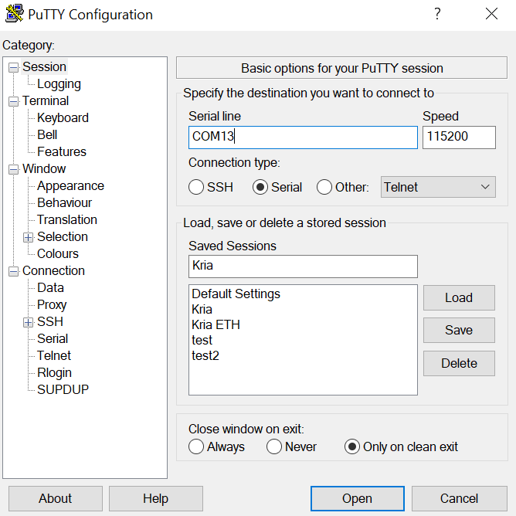
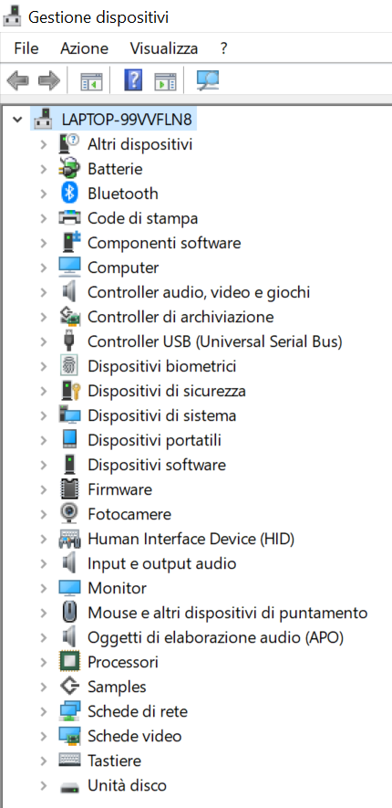
PuTTY
Download PuTTY: https://putty.org/index.html (on ubuntu: sudo apt install putty);
Run it and set up the connection with the parameters shown earlier;
To find the COM port you can go to the Manage Devices tab in the Control Panel (on ubuntu: ls /dev | grep tty OR ls /dev | grep USB )
Notes:
Lines in both italics and bold are Linux Shell commands.

Slide 6
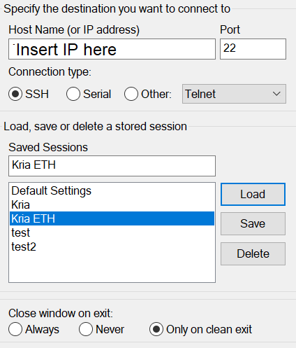
Step 2: Kria connection test
Once the PuTTY connection starts up successfully, connect the Kria’s power cable. The PuTTY window should start showing some text;
After the boot up is complete, you will need to set a username and password (recommendation is the same thing for both, forgetting the password is bad!);
Once logged in, it’s strongly recommended to connect the Kria to the internet via ethernet, it will make uploading files to it much less time consuming (good for repeated tests!);
If you connect to the internet, you can find out your IP address via ifconfig ;
The Kria’s IP address can be used to connect with PuTTY via Ethernet as well, as it’s a more stable connection than using UART
Notes:
This test verifies if we can connect successfully to the board and if we have installed the Ubuntu operating system (henceforth called OS) correctly.

Slide 7
After login, we are here
After login, we are here
Notes:
By default, after the login operation the system puts the shell inside the directory ‘/home/[username chosen during login]’.

Slide 8
Step 3: File transfer
To transfer files to your Kria there are two options:
FTP allows you to transfer files quickly but requires the Kria to be connected to the internet and third party software for FTP (e.g. Filezilla);
Manual is much slower, requires a way to work with ext4 file systems (Windows can’t interact with it easily, so it’s recommended to set up a Ubuntu dual boot on your PC if you have Windows) and a micro SD to USB adapter (or any other way to insert the SD into your PC), but it doesn’t require an internet connection.
Using your method of choice, upload the github repository on the Kria (or you can run sudo apt install git and git clone https://github.com/mdc-suite/AXI-based-drivers if you have internet access);
Remember to run sudo bash install_libs.sh as well to install all the necessary tools for development
Notes:
As mentioned earlier, lines in both italics and bold are Shell commands.
It is highly recommended to set up some form of FTP software, as it makes transfering files much less tedious.

Slide 9

Step 4: Driver test
On the Kria, navigate to the axidma-driver folder;
Run make to compile the driver;
Run sudo insmod axidma.ko to insert the driver into the kernel;
If you run sudo dmesg you should see the driver insertion logs;
Driver is inserted here
Driver is inserted here
Notes:
It is possible to adjust the driver to work for a generic FPGA interface by tweaking the functions and the device-tree, but implementing it would imply more limited kernel side control of the hardware, or direct control of the hardware from userspace using pointers to PL addresses, increasing the risk of runtime errors and crashes.
In most cases, a driver specialized to the PL interface in use is preferable.

Slide 10
Step 4: Driver test
Run sudo fpgautil –b aes256_dma.bin to load the bitstream;
Run dtc –i pl.dtsi –o pl.dtbo -@ to compile the device-tree overlay;
Run sudo fpgautil –o pl.dtbo to insert the overlay;
Run sudo dmesg again: you should see that the driver has detected the overlay;
Overlay is inserted here
Bitsream is loaded here
Notes:
If different hardware is used the device-tree overlay has to be changed as well in order to match it, instructions are in the repository README.
Vivado is the recommended tool to use for hardware development for any kind of AMD/Xilinx platform (like the Kria).

Slide 11
Step 4: Driver test
Test program starts here
Compile dma_test.c with gcc dma_test.c –o dma_test ;
Run the test with ./dma_test ;
ioctl is called (system call)
Kernel sees system call
Call is for driver
Driver executes system call, addresses hardware
Notes:
The animations here illustrate the flow of operations on the system diagram when the driver is used (i.e. when a system call is used in a program).

Slide 12
Step 4: Driver test
Value is returned to userspace
Return path
ioctl returns requested value
Driver sends result back to the kernel
Hardware executes operation
Notes:
After the result is produced, it takes the opposite path from earlier, going back up through the kernel to finally end up in userspace (our application), where it was requested.

